Slide 1
RECALL Resilient European Communities Against Local Landslides

Slide 2
RECALL Resilient European Communities Against Local Landslides
KICK OFF MEETING
Projects selected under the 2014
Call for Proposals for Prevention & Preparedness projects in civil protection and marine pollution
Brussels, 20 January 2014

Slide 3
Presentation of the beneficiary and partners (1/2)
Coordinator (CO): Province of Vicenza (Italy)
Beneficiary (AB1): Geological Survey of Slovenia (Slovenia)
Beneficiary (AB2): Region Of Western Macedonia (Greece)
Beneficiary (AB3): University of Debrecen (Hungary)
Beneficiary (AB4): Vukovar-Srijem County (Croatia)

Slide 4
Presentation of the beneficiary and partners (2/2)
Geological Survey of Slovenia
Technical partner with great experience on landslide risk mapping, prevention measures development and which have participated as partner or coordinator in past ED funded projects, in particular AdaptAlp, Safe Land, Terrafirma which results will be imported and shared within RECALL. Responsible of analysis and training.
University of Debrecen
Scientific partner, expert in economics, able to guide local authorities in the correct financial resources allocation and budget planning.
Responsible of е-tools development
Province of Vicenza,
Region Of Western Macedonia and Vukovar-Srijem County
Will involve, besides their internal organization, civil protection volunteering associations, citizens and groupsof interest in selected pilot areas which often encounter landslide events and wish to mitigate disaster risk andrelated consequences.

Slide 5
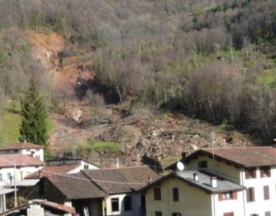
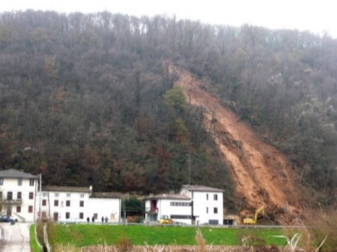
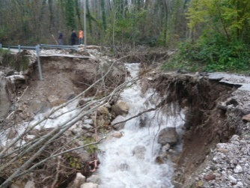
Costs
Total eligible cost: EUR 503.821,00
EC co-financing: EUR 377.866,00 (75% of total e.c.)
Duration of the action: 24 months as of 04/05/2015

Slide 6
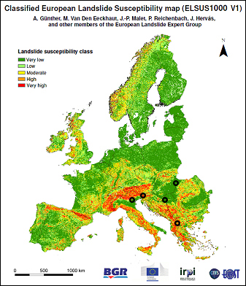
Presentation of RECALL PROJECT
RECALL focuses on two main European thematic strategies: Soil Protection and Disaster Risk Management.
The objective of the Soil Protection Strategy adopted in September 2006 is to protect the soil while using it sustainably, through the prevention of further degradation, the preservation of soil function and the restoration of degraded soils.
The 2010 Status of the Environment Report of the European Environment Agency demonstrates that soil degradation is increasing and among the different examples proving this, landslides are a major threat in mountainous and hilly areas across Europe.
The Landslide susceptibility in the EU and neighbouring countries map shows in red the most affected areas when speaking of landslide phenomena, among which RECALL partners' areas.

Slide 7
Presentation of RECALL PROJECT
As described in ECHO Factsheet Disaster Risk Management (April 2014), geological events (among which landslides) are considered the most likely cause of disaster in Europe.
Lots of important steps have been done towards harmonised approaches for delineating areas at risk of landslides, common thematic datasets, models for landslide susceptibility assessment at European and national scales and most of this has been done thanks to the cooperation at EU level.
The results achieved so far, allow local authorities to assess their territory risk level or to forecast landslide susceptibility and inform them on the best prevention measures that can be adopted.

Slide 8
Presentation of RECALL PROJECT
In order to improve the methodologies developed so far, what is missing is, given a specific territory and a fixed budget to be used for risk prevention, where to allocate the budget in order to assure the best results and decrease disaster risk level and consequences in case of disaster happening.
Within the panorama of actions done so far at European and national level, RECALL aims to take a step forward in risk prevention, moving to cost - benefit examination and efficient financial resources management and allocation, which is now a huge criticality in local communities destined to become a focal point in the upcoming years, in parallel with the increasing scarcity of financial resources available at local level.
Main objectives are: developing an efficient and effective methodology for risk analysis, territorial monitoring, data collection, costs analysis for prevention measures and best budget allocation at local level within public territorial entities.

Slide 9
Presentation of RECALL PROJECT
RECALL is structured in 4 simple tasks, besides coordination and dissemination actions.
1. Detailed analysis of the state of the art of reinforcement measurement, state of maintenance, priorities of investments in 4 European pilot areas (Italy, Croatia, Greece, Slovenia) which present high levels of landslide risk and interest more than 5.000 inhabitants - at project level.
2. Specific training developed for local civil protection authorities and selected groups of citizens, in order to create at least 4 cooperative teams locally established and periodic monitoring of the state of the art of landslide prevention measurements.
3. Execution of small structural interventions in the selected pilot areas.
4. Development of 2 specific e-tools: one that allows cooperative teams to communicate with their local authority through shared vocabularies, formats and protocols and one that guides local authorities in planning budget allocation in advance and in assessing the correct priorities in investments.

Slide 10
Presentation of RECALL PROJECT
Expected results
Increased capacity of territorial entities of managing the available resources (financial and human)
Increased capacity of territorial entities of assessing prevention measures' level of priority
Increased involvement of local communities in risk prevention measures and strategies
Increased capacity of local communities to develop adaptation strategies to climate changes
Increased integration of disaster prevention in economic and financial decisions and strategies
Increased knowledge in landslide prevention measures and further contribution to the efforts done so far at international level

Slide 11
Tentative dates and places for Major Events
3 partnership meetings between 04/05/2015 and 28/04/2017
8 indoor and outdoor training sessions between 30/05/2015 and 29/02/2016
12 monitoring sessions, on field, in the 4 pilot areas between 01/06/2015 and 28/02/2017
1 training session for territorial entities between 01/10/2015 and 15/04/2017
Summary
no. 4 local events (Project Countries)
no. 5 public events (Bruxelles, Vicenza, Vukovar, Debrecen, Ljubjana) for project presentation and final events between 04/05/2015 and 28/04/2017

Slide 12
Follow up
RECALL will develop and test a new methodology for land protection and landslide prevention, to be adopted by the competent territorial entity and that will be able to give appreciable results, thanks to the cooperation with the local interested communities which live in areas characterized by landslide risk.
It is important to underline that the 2 years project will allow project partners to set the general organization, test it, improve it and validate it but in order to assure that all the activities and the efforts that will be done during project implementation do not vanish at the end of the project and to facilitate the transfer of the methodology in other areas at risk, it will be necessary that:
cooperative teams will continue with their periodical monitoring activity and by intervening with local small interventions, when necessary;
territorial entities will continue to use the developed tools, starting to execute comparative annual analysis in order to calculate if the RECALL methodology composed of cooperative teams, e-tools, cooperative teams activities has brought significant improvements in costs management and achieved results in landslide prevention.
In general, all the deliverables created thanks to RECALL will continue to exist and be operative and hoping they will bring to such satisfying results that will allow to extend the methodologies to other landslide affected areas.

